Slide 1

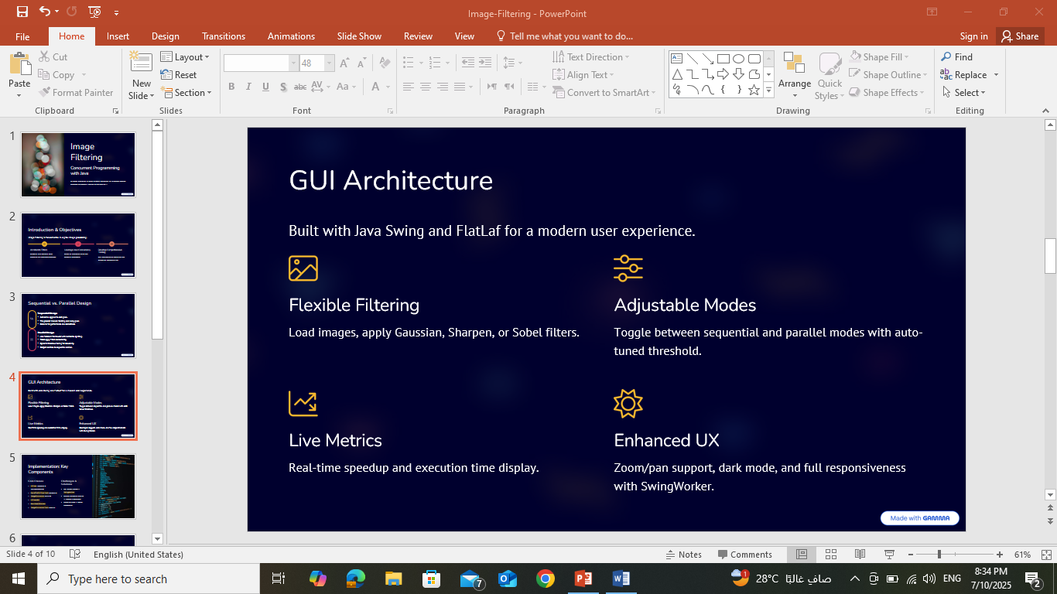
Parallel Image Filtering
Concurrent Programming with Java
By Rasha Hammoud & Faten Mortada
Supervisor: Dr. Mohamad AOUDE
Lebanese University – Faculty of Engineering III

Slide 2



Introduction & Objectives
Image filtering is fundamental in digital image processing.
Accelerate Filters
Leverage Java Concurrency
Develop Comprehensive Tooling
Gaussian blur, sharpen, edge detection are computation-heavy.
Speed up processing using the Fork/Join framework.
GUI, benchmarking, test suite, and Docker for reproducibility.

Slide 3


Sequential vs. Parallel Design
Sequential Design
3x3 kernel applied to each pixel.
The process involves iterating over every pixel
Baseline for performance and correctness.
Parallel Design
Java Fork/Join framework with horizontal splitting.
Tasks apply filters concurrently.
Dynamic threshold tuning for scalability.
Output identical to sequential version.

Slide 4




GUI Architecture
Built with Java Swing and FlatLaf for a modern user experience.
Flexible Filtering
Modes
Load images, apply Gaussian, Sharpen, or Sobel filters.
Run both sequential and parallel modes with auto-tuned threshold.
Live Metrics
Enhanced UX
Real-time speedup and execution time display.
Zoom/pan support, dark mode, and full responsiveness with SwingWorker.

Slide 5
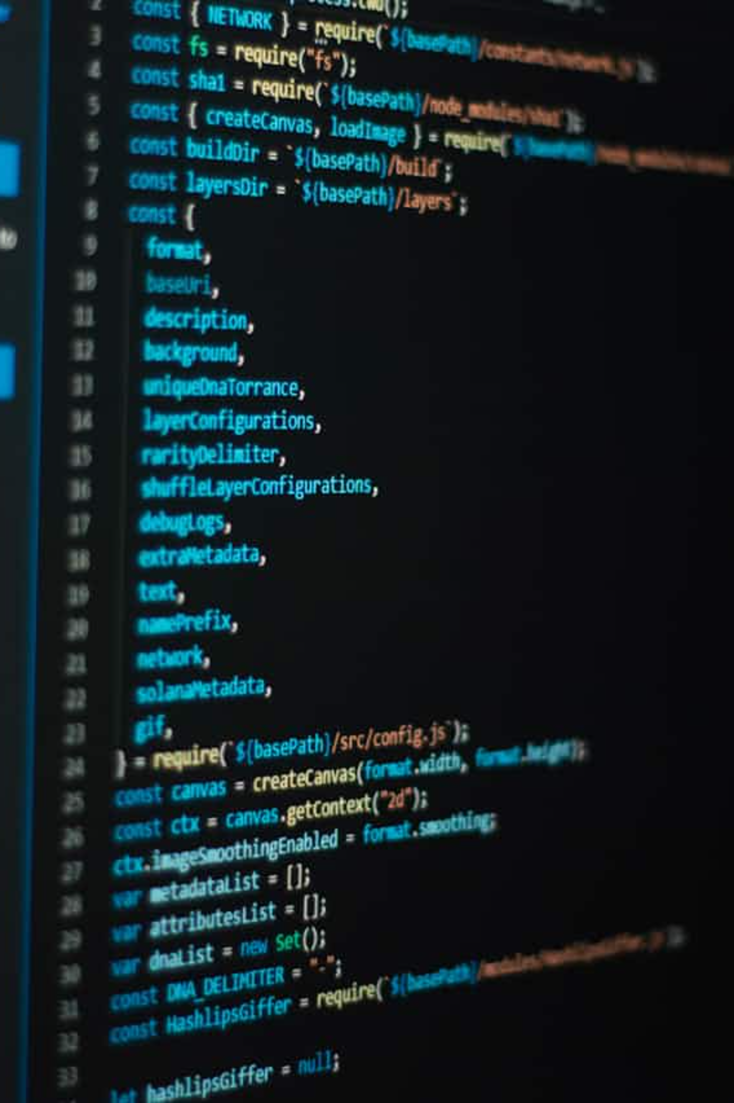
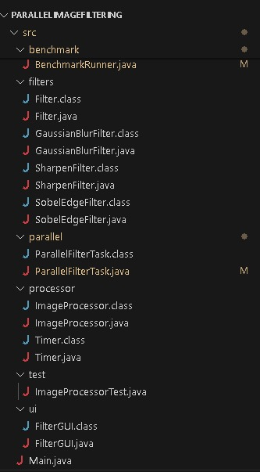
Implementation
Core Classes
Filter Interface & Implementations
ParallelFilterTask (Fork/Join)
ImageProcessor Utilities
FilterGUI
BenchmarkRunner
ImageProcessorTest (JUnit 5)

Slide 6
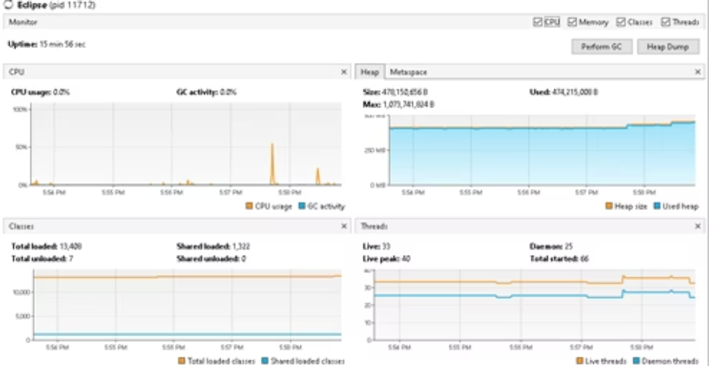
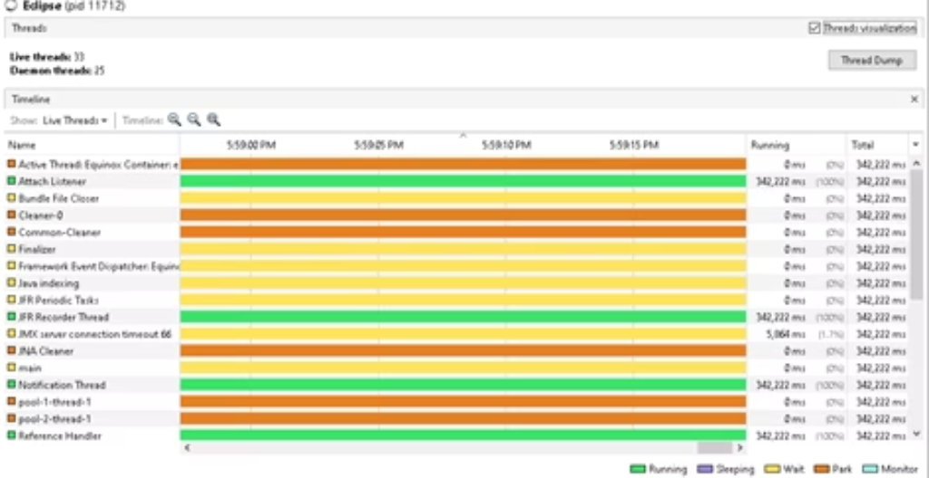
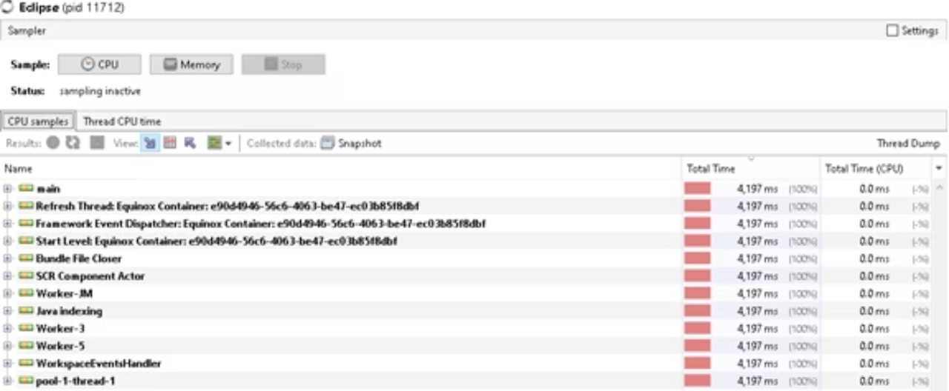
Testing Methodology
Correctness (JUnit 5)
Pixel-by-pixel output comparison.
Validation of filters and threshold tuning.
Ensures mode-agnostic output integrity.
Performance & Profiling
System.nanoTime() for precise timing.
Averaged over 4 runs with BenchmarkRunner.
VisualVM for CPU usage, active threads,
and sampling behavior.

Slide 7
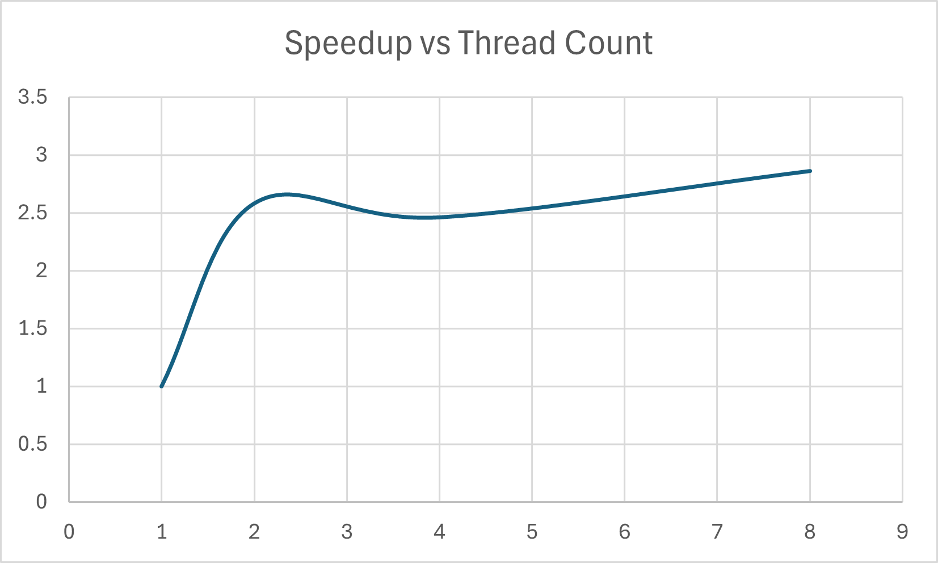
Benchmark Results: Gaussian Blur
Test Image: 1920x1080 pixels
Achieved a 2.86x speedup with 8 threads, reaching approximately 36% of ideal linear scaling.

Slide 8
Sequential vs. Parallel: A Comparison
Sequential
Parallel (8 threads)
Time
0.103 s
0.036 s (~3x faster)
Output Match
Exact
Exact
CPU Utilization
~15%
~90%
Memory Overhead
1x
~1.4x (Acceptable increase)
Identical results with significantly improved performance and sustained GUI responsiveness.

Slide 9



Conclusion
Significant Performance Gains
Usability & Visibility
Accuracy Maintained
Java concurrency improved filter processing up to 3x faster.
GUI and benchmarking tools enhance user experience and insight.
Parallel results are as accurate as sequential counterparts.

Slide 10
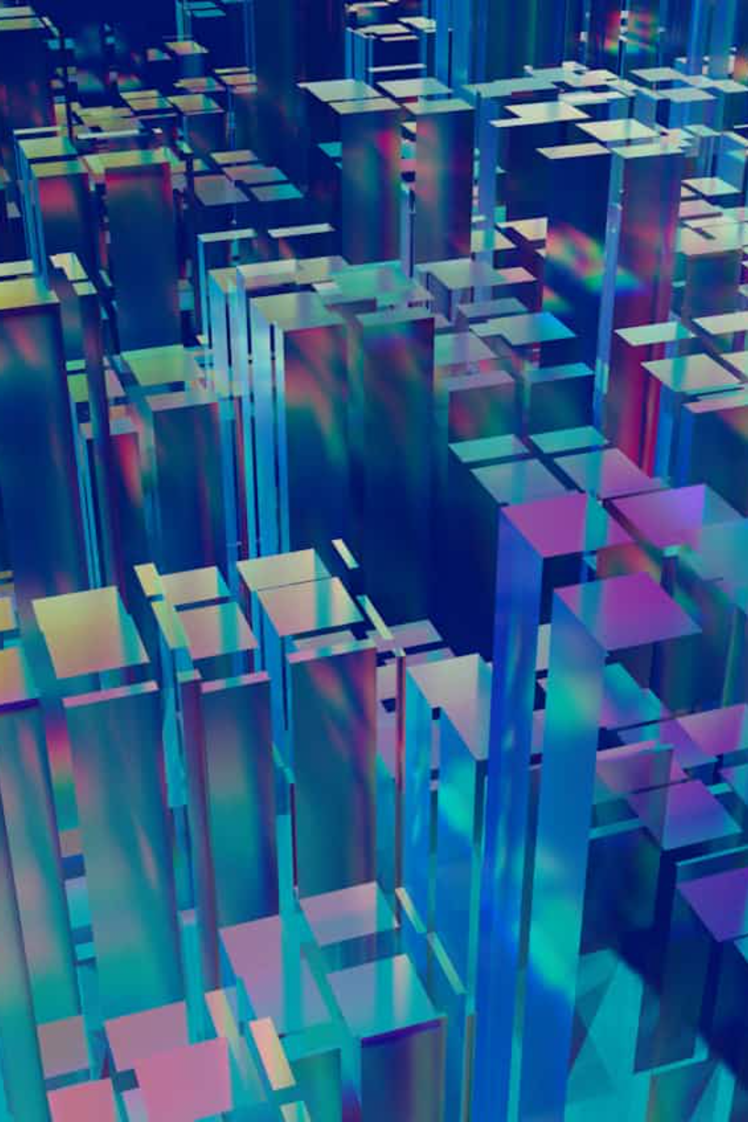




Future Improvements
Web-based GUI
Modernize the user interface with JavaFX for desktop or a React + Spring Boot web application.
Expanded Filters
Integrate a broader library of filters, including median, emboss, and bilateral for more diverse effects.
Batch Processing
Enable efficient multithreaded processing for handling large datasets of images concurrently.
Smarter Auto-tuning
Implement dynamic threshold adjustment based on real-time system specifications for optimal performance.

